Slide 1

Constructing a Parser Tree
Sabrina Tarin Chowdhury

Slide 2
Recap
So far we have seen
How the tokens are generated in lexical analysis
How the parsing tree is formed in syntax analysis

Slide 3
Parsing
It turns out that for any CFG we can create a parser that runs in O(n³) time
O(n³) time is clearly unacceptable for a parser in a compiler - too slow even for a program of 100 tokens (~1,000,000 cycles)

Slide 4
Parsing
Fortunately, there are large classes of grammars for which we can build parsers that run in linear time
The two most important classes are called LL and LR
LL stands for Left-to-right, Leftmost derivation
Leftmost derivation - work on the left side of the parse tree
LR stands for Left-to-right, Rightmost derivation
Rightmost derivation - work on the right side of the tree
LL parsers are also called 'top-down', or 'predictive' parsers
LR parsers are also called 'bottom-up', or 'shift-reduce' parsers

Slide 5
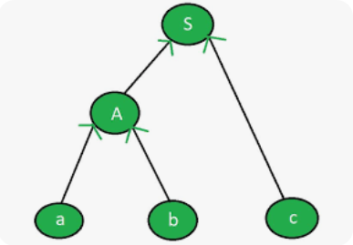
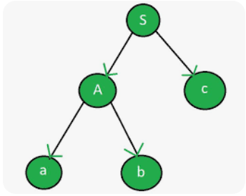
Parsing
LL parsers are also called 'top-down', or 'predictive' parsers
LR parsers are also called 'bottom-up', or 'shift-reduce' parsers

Slide 6
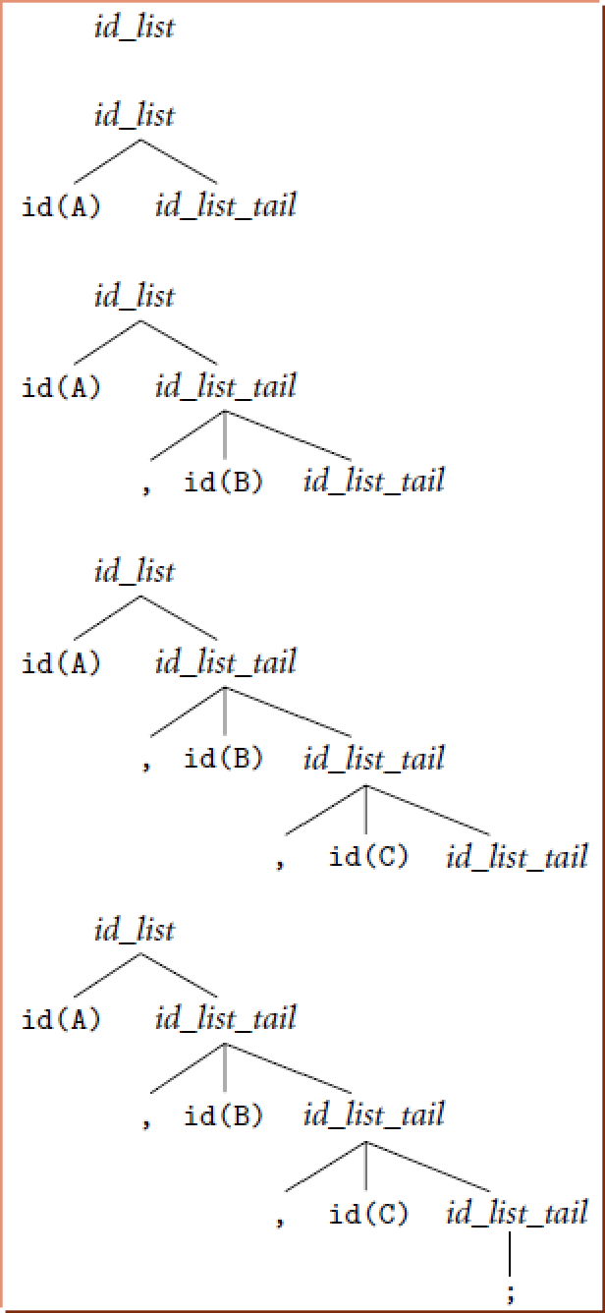
Top-down parsing (LL)
Consider a grammar for a comma separated list of identifiers, terminated by a semicolon:
id_list → id id_list_tail id_list_tail → , id id_list_tail id_list_tail → ;
The top-down construction of a parse tree for the string: “A, B, C;” starts from the root and applies rules and tried to identify
nodes.

Slide 7
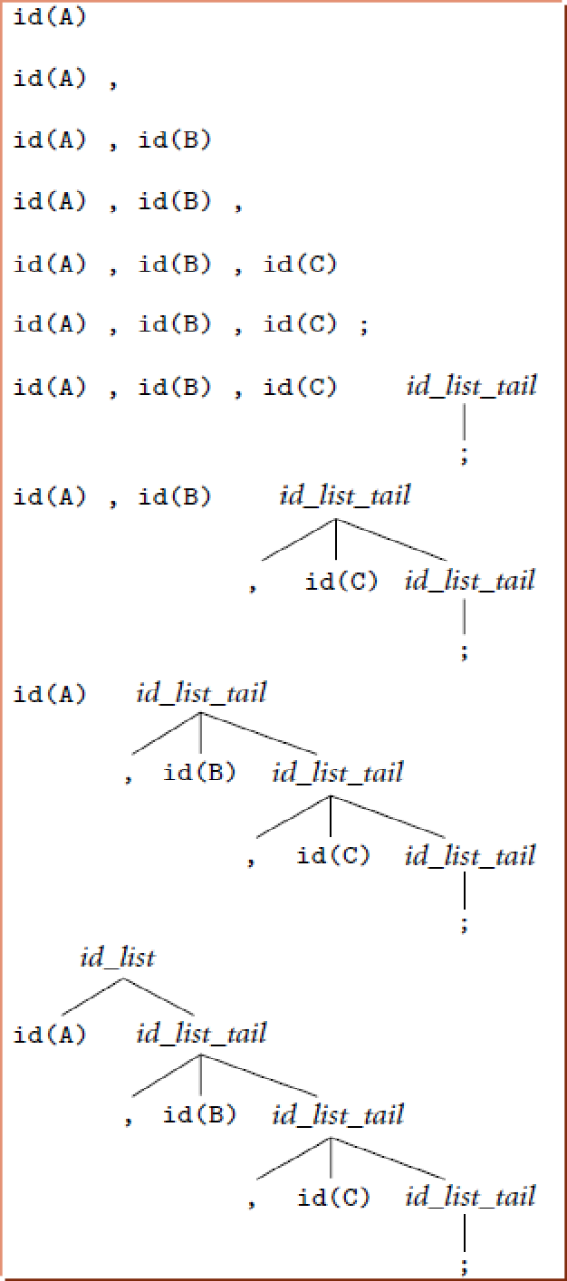
Bottom-up parsing (LR)
id_list → id id_list_tail id_list_tail → , id id_list_tail id_list_tail → ;
The bottom-up construction of a parse tree for the same string: “A, B, C;”
The parser finds the left-most leaf of the tree is an id. The next leaf is a comma. The parser continues in this fashion, shifting new leaves from the scanner into a forest of partially completed parse tree fragments.

Slide 8
Bottom-up parsing (LR)
The bottom-up construction realizes that some of those fragments constitute a complete right-hand side.
In this grammar, that occur when the parser has seen the semicolon— the right-hand side of id_list_tail.
With this right-hand side in hand, the parser reduces the semicolon to an id_list_tail.
It then reduces ", id id_list_tail" into another id_list_tail.
After doing this one more time it is able to reduce "id id_list_tail" into the root of the parse tree, id_list.

Slide 9
Parsing
The number in LL(1), LL(2), …, indicates how many
tokens of look-ahead are required in order to parse
Almost all real compilers use one token of look- ahead
LL grammars requirements:
no left recursion
Right recursion in production tends to require very deep stacks and complicates semantic analysis

Slide 10
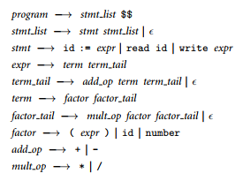
An LL(1) Grammar For Simple Calculator

Slide 11
An LL(1) Grammar For Simple Calculator
The calculator allows values to be read into (numeric) variables, which may then be used in expressions.
Expressions in turn can be written to the output.
Control flow is strictly linear (no loops, if statements, or other jumps).
The end-marker ($$) pseudotoken is produced by the scanner at the end of the input. This token allows the parser to terminate cleanly once it has seen the entire program.
As in regular expressions, we use the symbol ‘ϵ’ to denote the empty string.

Slide 12
LL Parsing
This grammar captures associativity and precedence, but most people don't find it as pretty
The first parsers were LL
How do we parse a string with this grammar?
by building the parse tree incrementally

Slide 13
LL Parsing
Example (the average program):
read A read B
sum := A + B
write sum
write sum / 2 $$
We keep a stack of non-terminals with the start symbol inserted
LL parse table
We start at the top and predict needed productions on the basis of the current "left-most" non-terminal in the tree and the current input token

Slide 14
LL Parsing
Table-driven LL parsing: you have a big loop in which you repeatedly look up an action in a
two-dimensional table based on current leftmost non-terminal and current input token
The actions are:
match a terminal
predict a production OR
announce a syntax error

Slide 15
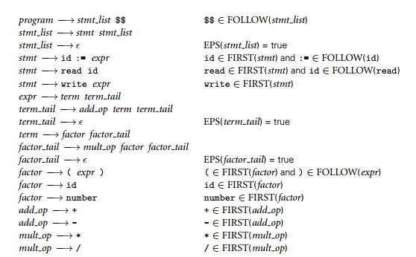
First and Follow Sets in Simple Calculator
FIRST(A) is the set of all tokens that could be the start of an A and FOLLOW(A) is the set of all tokens that could come after an A in some valid program.
Non-terminals cannot be the member of a set.
Grammar Breakdown
First and follow sets
Main Grammer

Slide 16

First Set
All the non-terminals will have a first set.
First and follow sets
First sets Collection Summary
Main Grammer

Slide 17

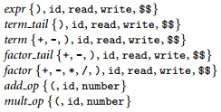
Follow Set
Follow sets Collection Summary
First and follow sets
Main Grammer

Slide 18
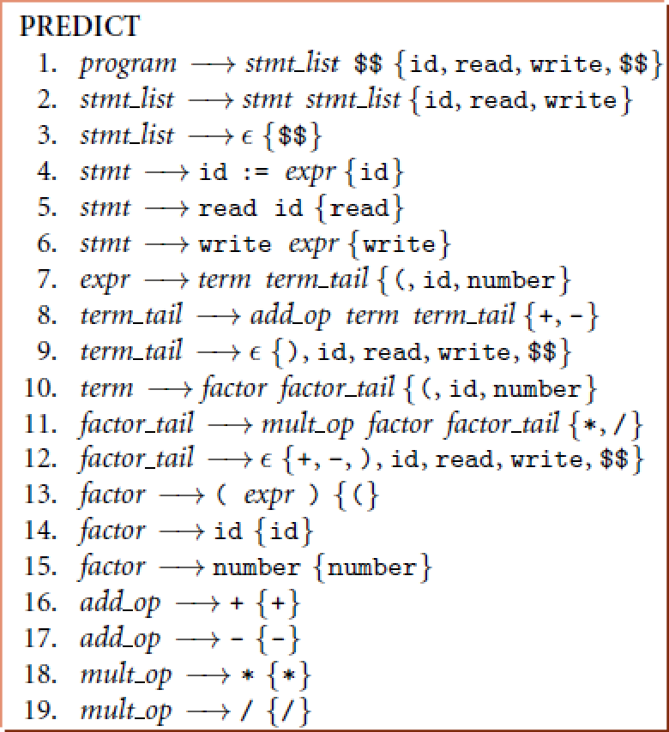
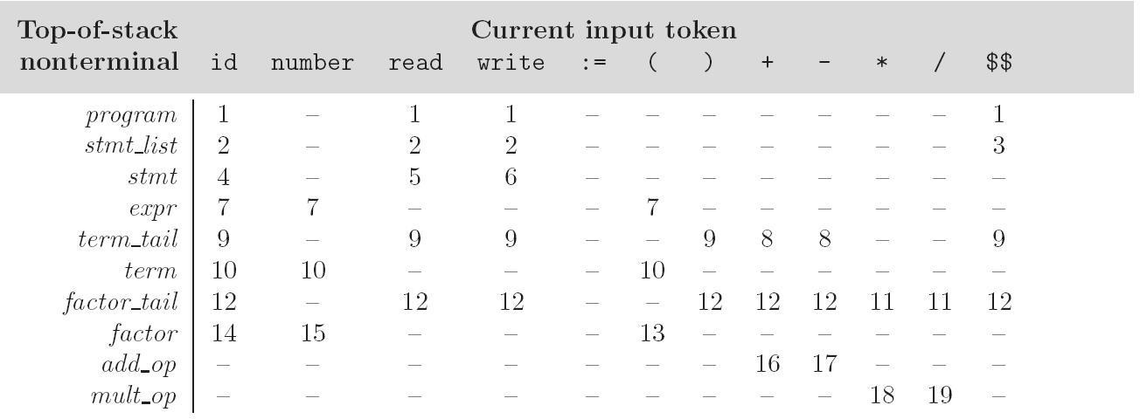
LL Parsing
Predict rule for a non terminal -> First set
If empty or EPS then follow set
Construct the prediction table: for each possible input token and the left-most nonterminal
The non-terminal will be "used", while the RHS of the production is added to the stack.
(c) Paul Fodor (CS Stony Brook) and Elsevier

Slide 19
LL Parsing
LL(1) parse table for parsing for calculator language
read A read B
sum := A + B write sum
write sum / 2 $$
(c) Paul Fodor (CS Stony Brook) and Elsevier

Slide 20
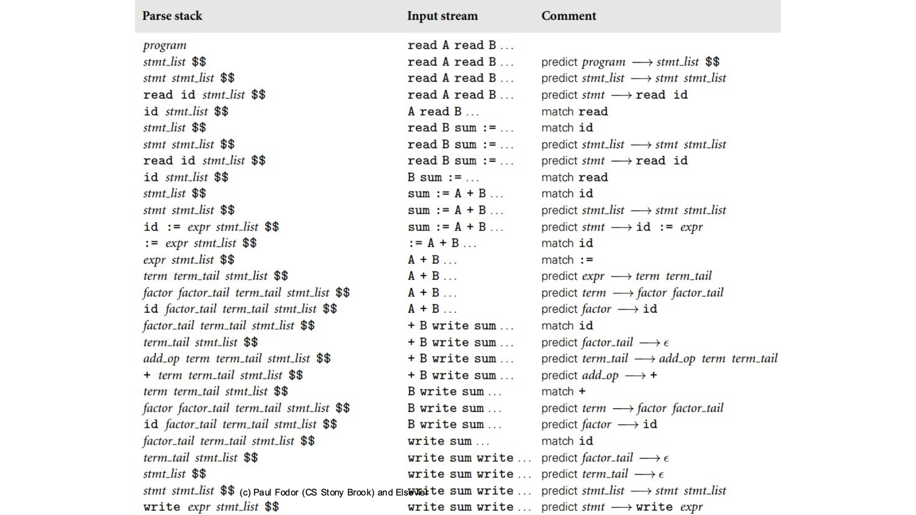
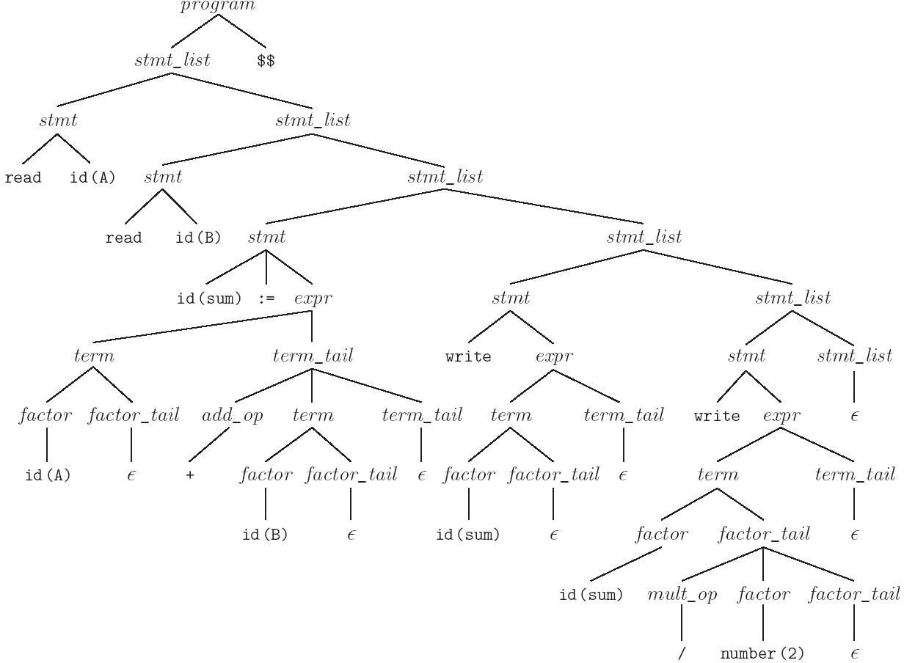
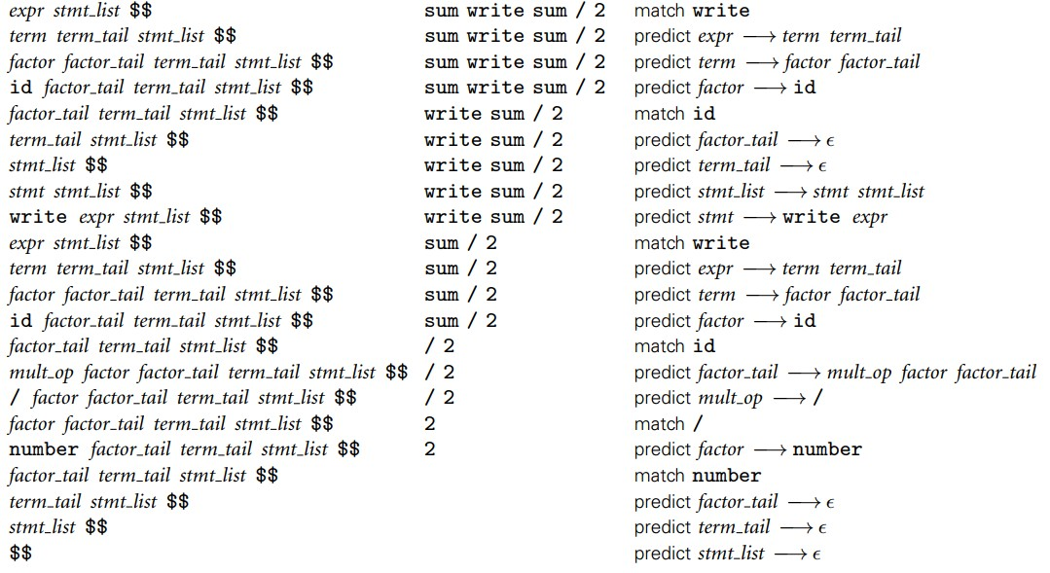
Parse tree for the average program

Slide 21
Programming
A parser generator is a programming tool that creates a parser, interpreter, or compiler from some form of formal description of a language and machine
the input is a grammar (usually in BNF) of a programming language
the generated output is the source code of a parser
Examples of parser generators:
classical parsing tools: lex, Yacc, bison, flex, ANTLR
PLY: python implementation of lex and yacc
Python TPG parser
ANTLR for python

Slide 22
Classic Parsing Tools
lex - original UNIX Lexical analysis (tokenizing) generator
create a C function that will parse input according to a set of regular expressions
yacc -Yet Another Compiler Compiler (parsing)
generate a C program for a parser from BNF rules
bison and flex ("fast lex") - more powerful, free versions of yacc and lex, from GNU Software Fnd'n.
Lexical Rules
Grammar Rules
Lex or Flex
Yacc or Bison
Input
char stream
Parsed Input
yylex()
yyparse()
token stream
C code
C code
Lexical Analyzer (Tokenizer)
Parser

Slide 23
PLY
PLY: Python Lex-Yacc = an implementation of lex and yacc parsing tools for Python by David Beazley: http://www.dabeaz.com/ply/
PLY is not a code generator
PLY consists of two Python modules
ply.lex = A module for writing lexers
Tokens specified using regular expressions Provides functions for reading input text
ply.yacc = A module for writing grammars
You simply import the modules to use them
The grammar must be in a file

Slide 24
TPG
TGP is a lexical and syntactic parser generator for Python
YACC is too complex to use in simple cases (calculators, configuration files, small programming languages, …)
You can also add Python code directly into grammar rules and build abstract syntax trees while parsing

Slide 25
AntLR
ANother Tool for Language Recognition is an LL(k) parser and translator generator tool
which can create
lexers
parsers
abstract syntax trees (AST’s)
in which you describe the language grammatically
and in return receive a program that can recognize and translate that language

